Slide 1
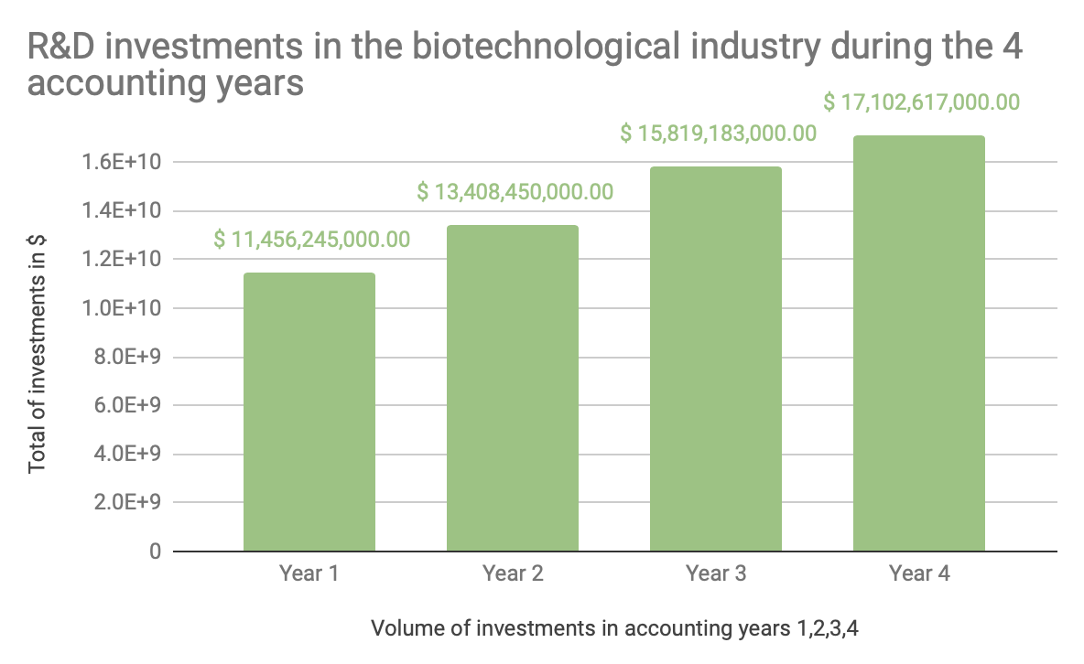
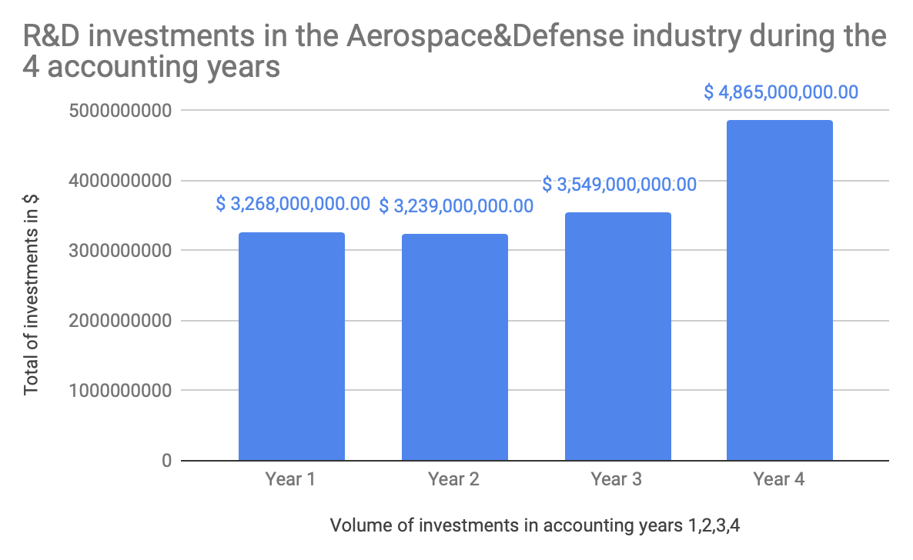
Which one of the Aerospace Defense and Biotechnological industries are safer for an investment in R&D researches?
Here are two bar charts of the R&D investments in the Aerospace Defence and Biotechnological industries during the 4 years of accounting that were provided in the data.
The chart for Biotechnology industry is right-skewed. The mean is therefore inferior to the median. The mean is however superior to the median in the Aerospace&Defense industry.
The Mean ($14,446,623,750) and the Median ($14,613,816,500) of the total R&D expenditures for companies in the Biotechnological industry almost reaches the same amount as the sum of the total investments in R&D for the Aerospace industry ($14,921,000,000). It does mean that companies in the Biotechnological industry have higher investments in R&D on average than all companies categorized under Aerospace. It appears that investments in the Biotechnological industry have constantly increased over the 4 years while the Aerospace industry had a decrease in Year 2 and then exponential increases in Year 3 and 4. This could be interpreted that the Biotechnological industry is safer for R&D investments. However, looking at other indicators, it turns out that the Aerospace Industry also has a smaller Range R&D investments ($1,626,000,000) compared to the Range of the Biotechnological Industry ($5,646,372,000), this could imply that the Aerospace industry is much safer for investments in R&D. This information seems to be confirmed by the Standard Deviation of the Biotechnological Industry ($2,513,854,202) that is much higher than the Aerospace R&D investment Standard Deviation ($769,309,376). The investments in the Biotechnological industry have a higher variability and could appear as less stable, despite what the chart is showing us.

